Slide 1


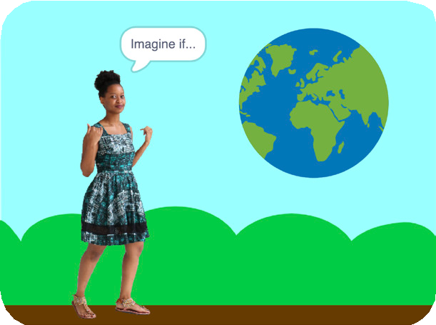
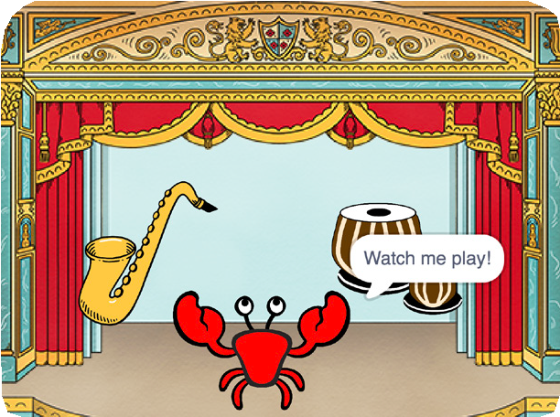

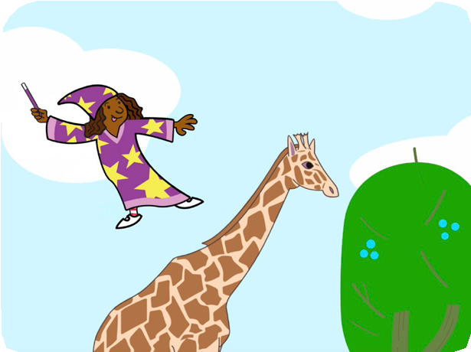
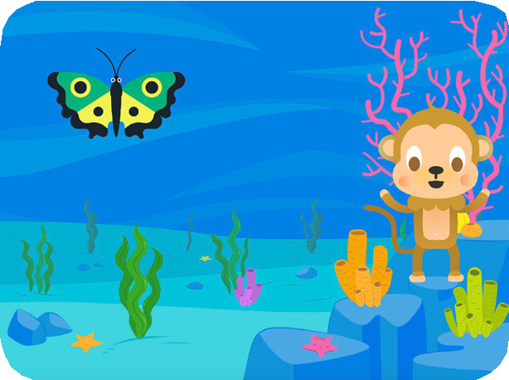

Imagine a World
Imagine a world where anything is possible!
scratch.mit.edu
Set of 9 cards

Slide 2

Imagine a World
Try these cards in any order:
Say Something
Fly Around
Go Right and Left
Go Up and Down
Change Costumes
Glide from Here to There
Grow and Shrink
Change Backdrops
Add a Sound
scratch.mit.edu
Set of 9 cards

Slide 3


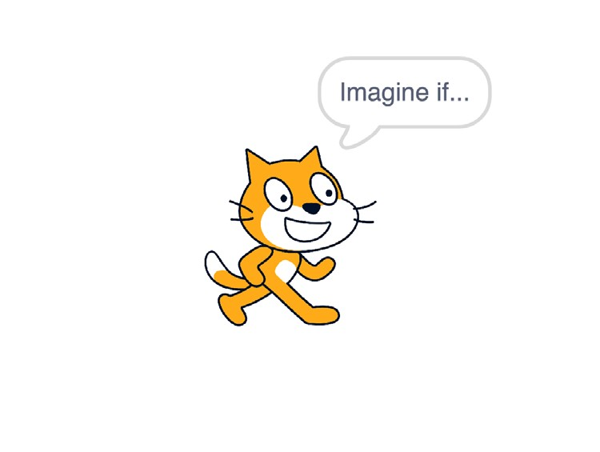

Say Something
Type what you want your sprite to say.
Imagine a World
1
Dance Party!

Slide 4
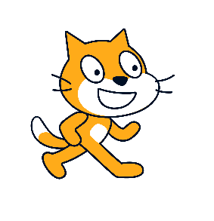
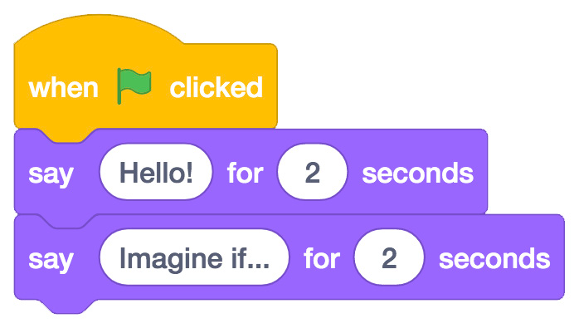

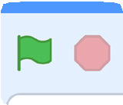
Say Something
scratch.mit.edu
GET READY
Sprite1
Select the sprite you want to talk.
ADD THIS CODE
Sprite1
Type what you want to say.
TRY IT
Click the green flag to start.

Slide 5
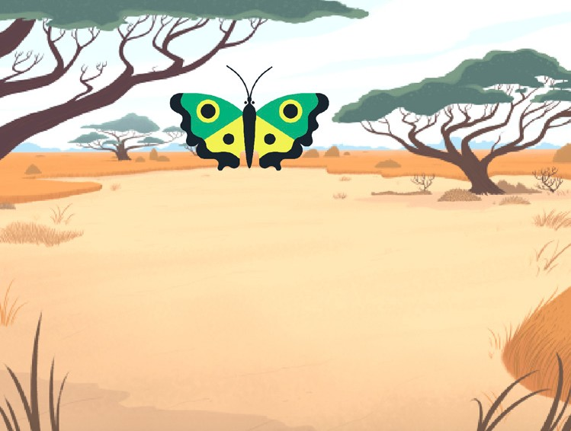
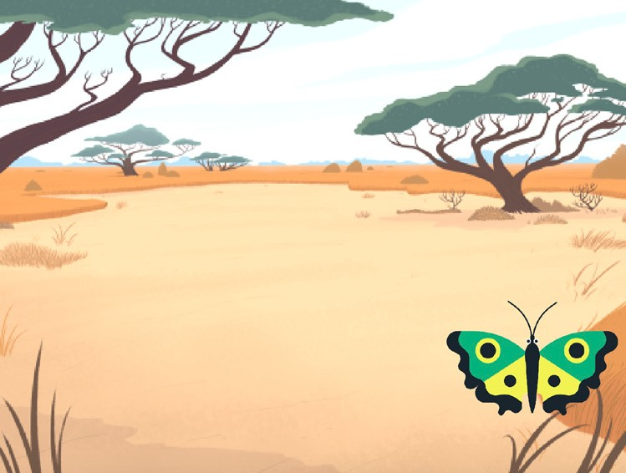
Fly Around
Press the space key to glide glide.
Imagine a World
2

Slide 6



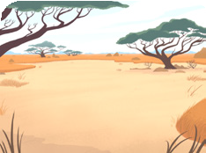
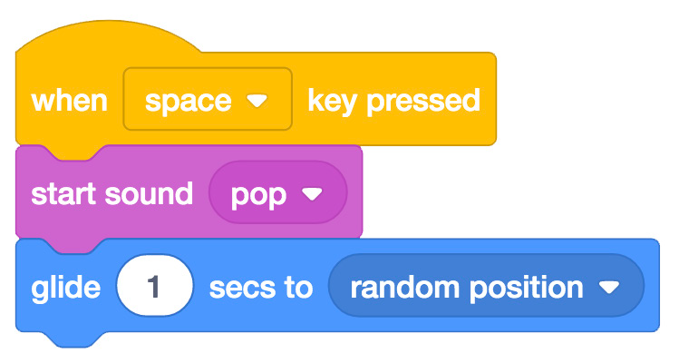

Fly Around
scratch.mit.edu
GET READY
Choose a sprite.
Butterfly 2
Choose a backdrop.
Savanna
ADD THIS CODE
Butterfly 2
TRY IT
Press the space key to glide.

Slide 7
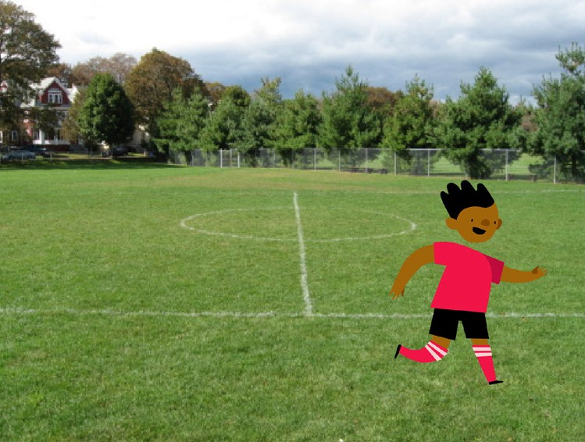

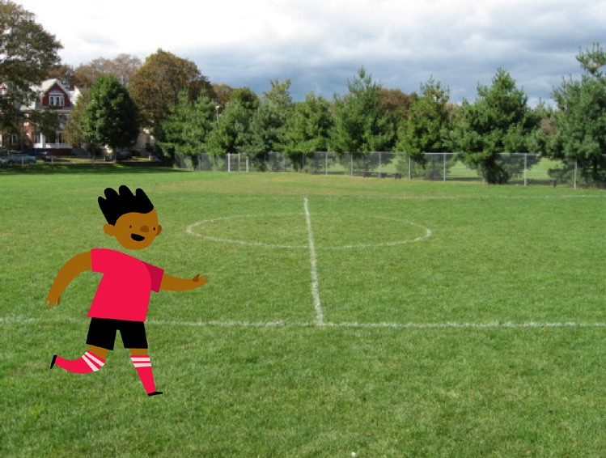

Go Right and Left
Press arrow keys to move right and left.
Imagine a World
3

Slide 8

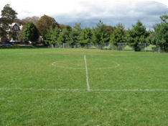
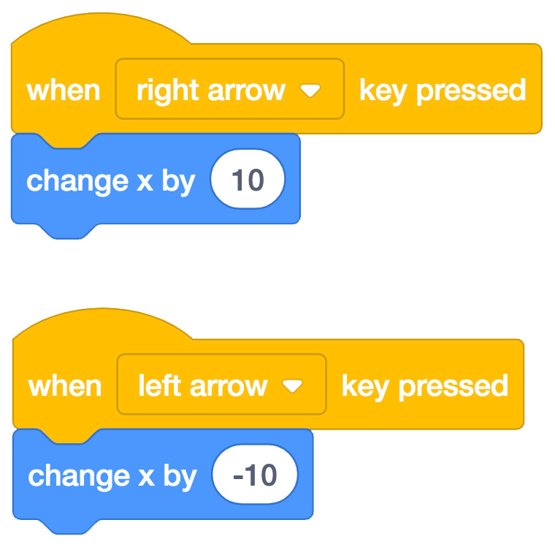





Go Right and Left
scratch.mit.edu
GET READY
Choose a sprite.
Ben
Choose a backdrop.
Playing Field
ADD THIS CODE
Change x to move your character side to side.
Ben
Type a minus sign to move left.
TRY IT
Press the right and left arrow keys on your keyboard.

Slide 9
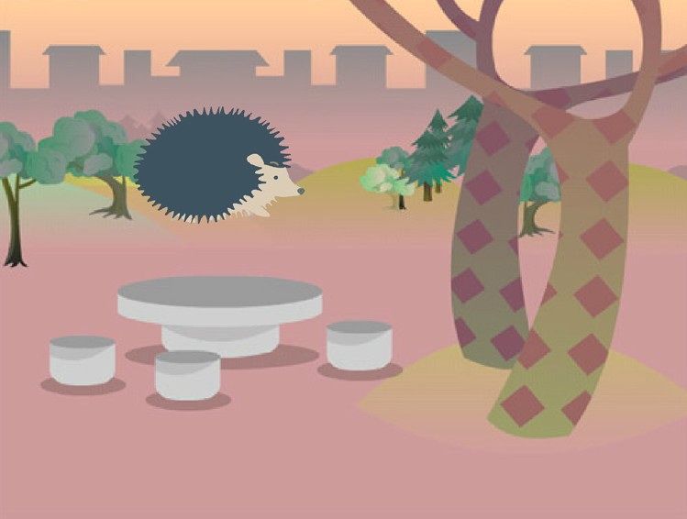

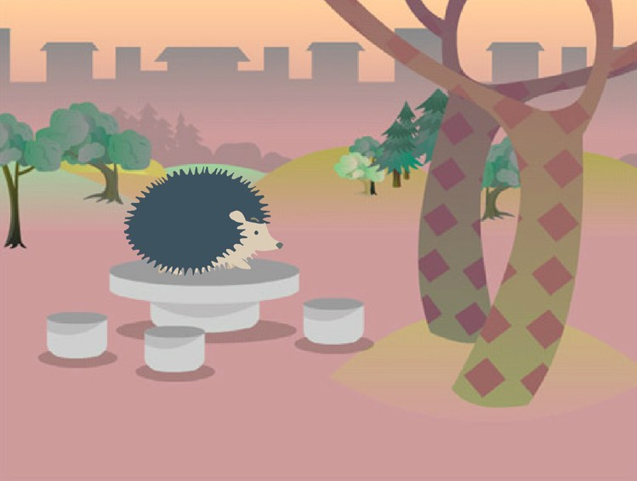

Go Up and Down
Press arrow keys to move up and down.
Imagine a World
4

Slide 10

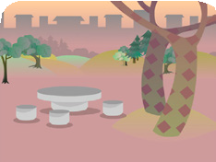

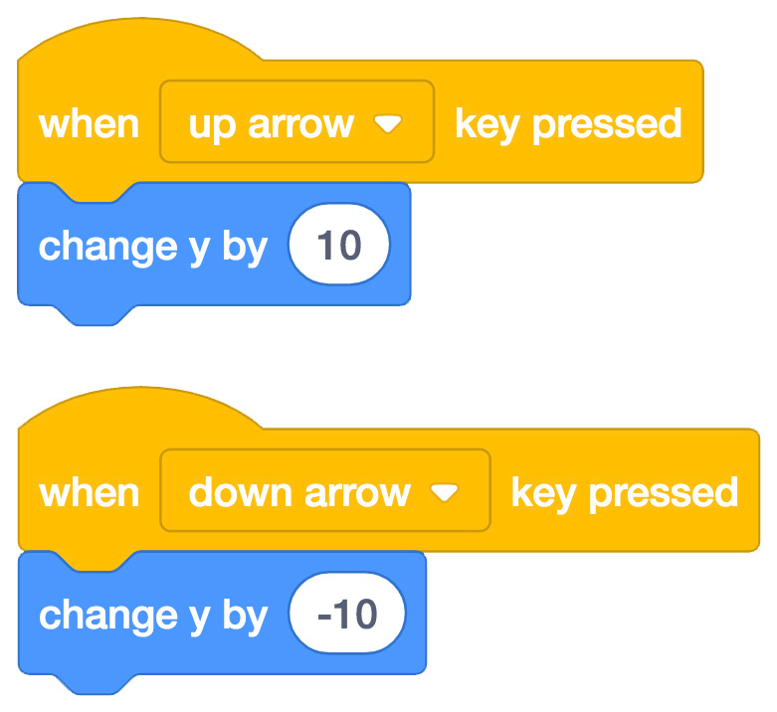




Go Up and Down
scratch.mit.edu
GET READY
Choose a sprite.
Hedgehog
Choose a backdrop.
Woods and Bench
ADD THIS CODE
Change y to move your character up and down.
Hedgehog
Type a minus sign to move down.
TRY IT
Press the up and down arrow keys on your keyboard.

Slide 11
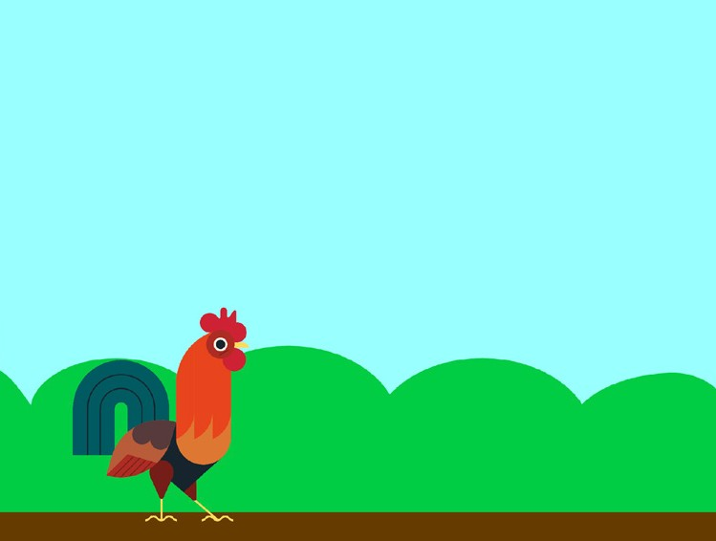
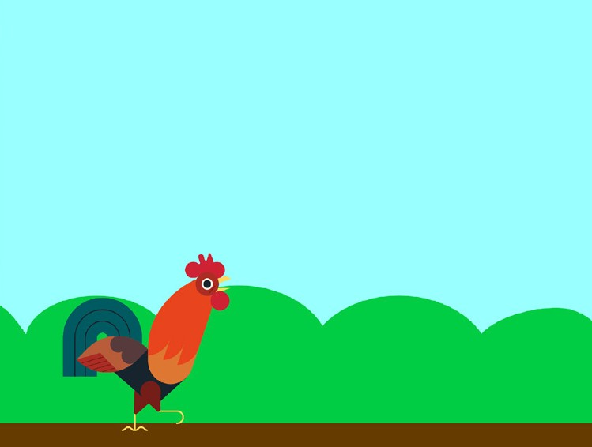

Change Costumes
Animate a sprite when you click it.
Imagine a World
5
Dance Party!

Slide 12



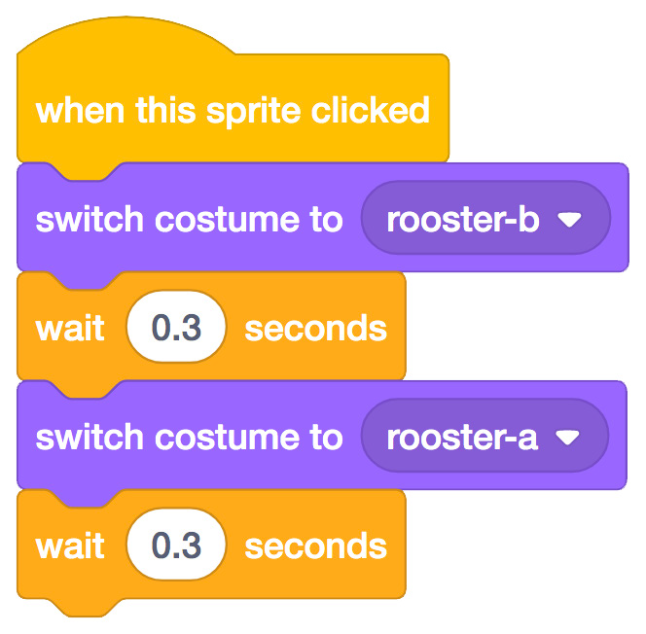


Change Costumes
scratch.mit.edu
GET READY
Choose a sprite.
Rooster
Choose a backdrop.
Blue Sky
ADD THIS CODE
Rooster
Choose one costume.
Choose another.
TRY IT
Click your sprite.

Slide 13


Glide From Here to There
Make a sprite glide from one point to another.
Imagine a World
6
Dance Party!

Slide 14


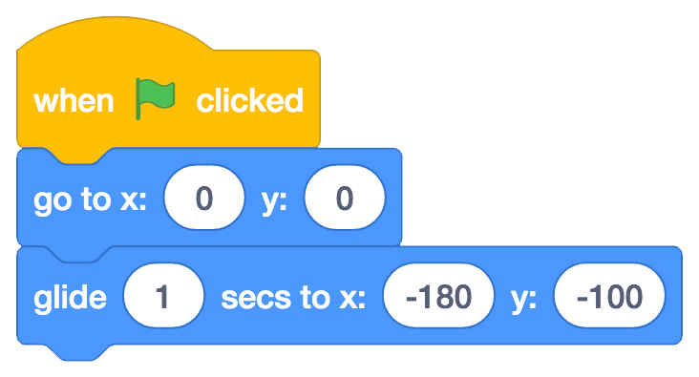


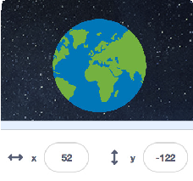

Glide From Here to There
scratch.mit.edu
GET READY
Choose a sprite.
Earth
Choose a backdrop.
Stars
ADD THIS CODE
Earth
Set the starting point.
Set the end point.
TRY IT
Click the green flag to start.
TIP
When you move a sprite, you can see the numbers for
x and y update.
x is the position from left to right.
y is the position up and down.

Slide 15
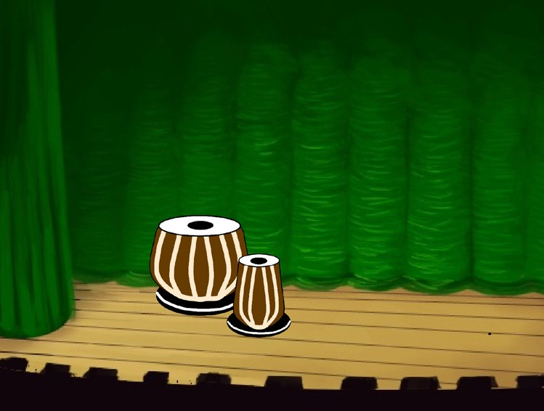
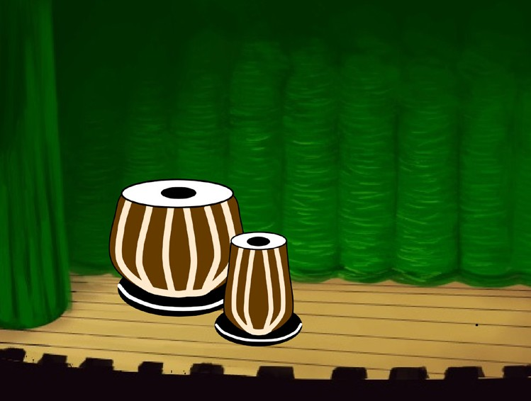



Grow and Shrink
Make a sprite change size when you click it.
Imagine a World
7
Dance Party!

Slide 16

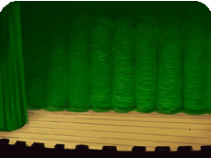


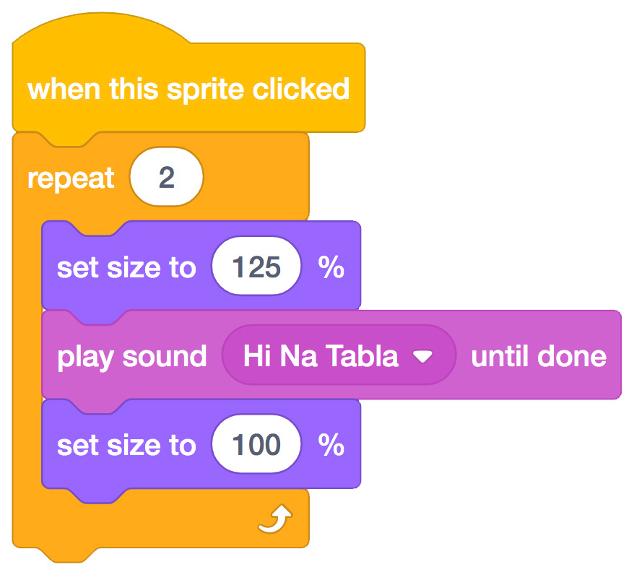

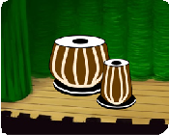
Grow and Shrink
scratch.mit.edu
GET READY
Choose a backdrop.
Theater 2
Choose a sprite.
Drums Tabla
ADD THIS CODE
Drums Tabla
Type a larger number to make it bigger.
Type 100 to return to original size.
TRY IT
Click your sprite.

Slide 17
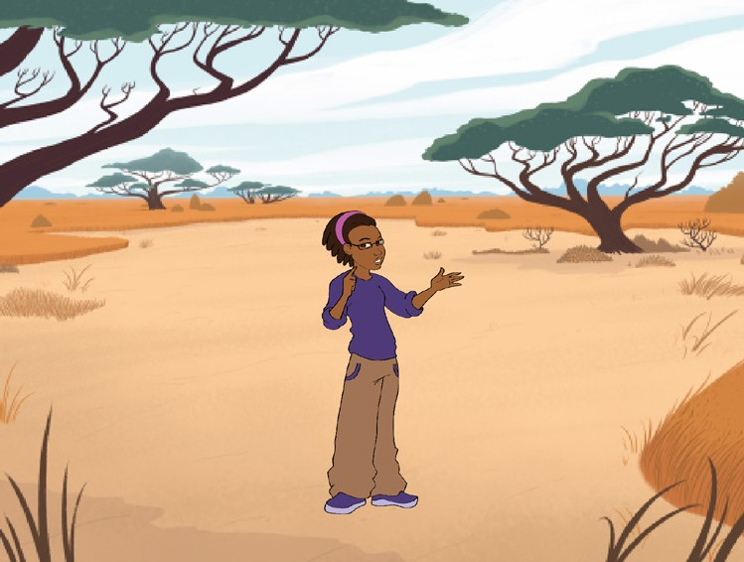
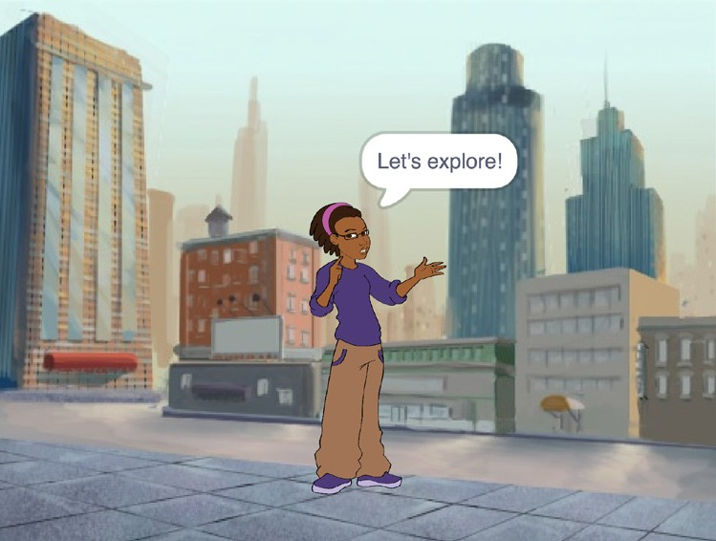
Change Backdrops
Change scenes by switching backdrops.
Imagine a World
8
Dance Party!

Slide 18
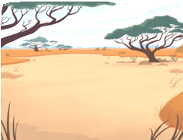
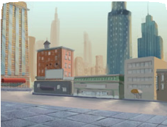
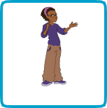
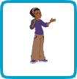
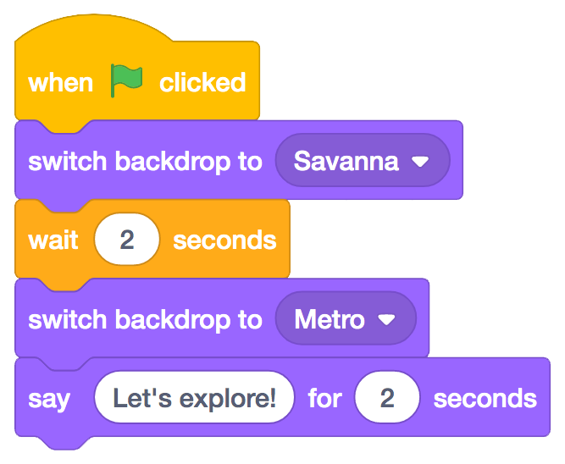
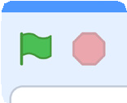
Change Backdrops
scratch.mit.edu
GET READY
Choose two backdrops.
Choose a sprite.
Savanna
Metro
Avery
ADD THIS CODE
Avery
Choose the backdrop
you want to start with.
Choose the second
backdrop.
Type what you want to say.
TRY IT
Click the green flag to start.
Create a Story

Slide 19
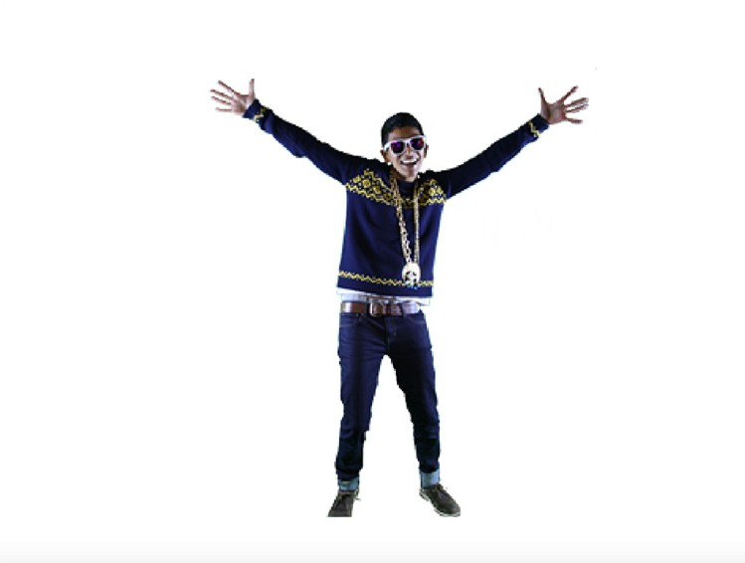
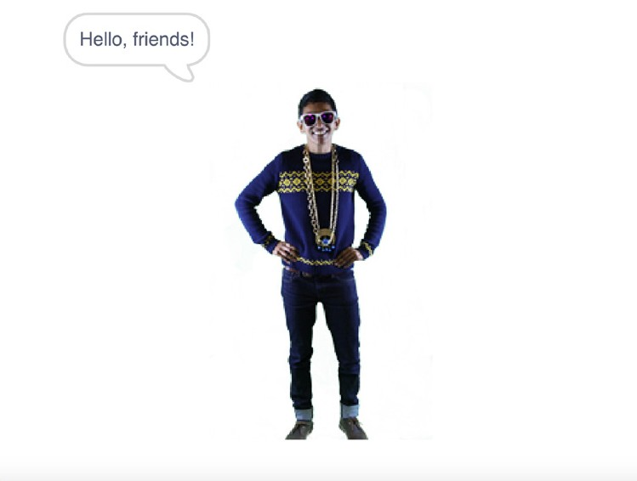
Add a Sound
Add your voice or other sounds to your project.
Imagine a World
9
DanceDance PPararty!ty!

Slide 20


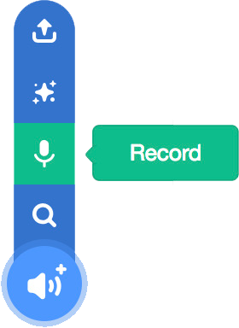
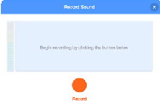



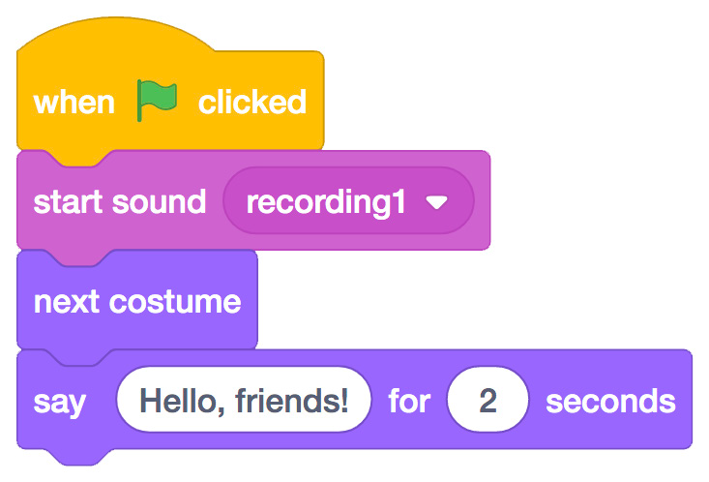

Add a Sound
scratch.mit.edu
GET READY
Choose a sprite.
Champ99
Click the Sounds tab.
Then click Record
from the pop-up menu.
To record your voice or other sound, click the red button.
Or, click here to choose a sound from the library.
If your device is unable to record, you can choose a sound.
ADD THIS CODE
Click the Code tab.
Select your sound.
Type what you want to say.
TRY IT.
Click the green flag to start.

